Slide 1



Reducing Red Tape at Scale
How shared procurement models deliver more with less

Slide 2

Reducing Red Tape at Scale
Faster Procurement
  Removing duplication that adds no value
Stronger Probity
  When designed once & applied consistently
Better Outcomes
  Reduce admin burden → Better value, smarter risk management, improved delivery..
Notes:
Procurement can be faster — not by cutting corners, but by removing duplication that adds no value.
Probity can actually be stronger — when it’s designed once, applied consistently, and not re-created under pressure in every Council.
And when procurement teams are freed from repetitive administrative work, they can focus on value, risk, and delivery — which is how we get better outcomes.
What I want to explore today is how shared procurement models make all three – risk, value and delivery true at the same time.
Key message:
The biggest gains in government procurement don’t come from cutting corners — they come from redesigning the system.

Slide 3
Red Tape isn’t the Enemy
Red tape isn’t the enemy
Probity isn’t the problem
DUPLICATION IS
  Repeating the same market engagement
  Re-running the same compliance checks
  Rebuilding the same evaluation frameworks
  Renegotiating the same contract terms
Notes:
Red Tape isn’t the Enemy
Probity is not the problem
Duplication is
Pause. Let this land.
Repeating the same market engagement
Re-running the same compliance checks
Rebuilding the same evaluation frameworks
Renegotiating the same contract terms - repeated again and again across Councils buying from the same market.
It’s not governance. It’s inefficiency.
Duplication is often driven by a desire for better outcomes — the question is whether repeating the same procurement steps is still the best way to achieve them

Slide 4

Defensive Procurement
When systems are fragmented - duplication becomes the default
Teams focus on proving process - rather than improving outcomes.
Notes:
Duplication leads to Defensive Procurement
Defensive procurement isn’t about poor capability — it’s a rational response to fragmented systems.
When each Council has to independently defend similar decisions, duplication becomes the safest option.
The focus is on process rather than outcomes
The issue isn’t mindset — it’s design.

Slide 5
The Real Question
The real question is:
Not: How do we cut steps?
But: Which steps should only be done once?
Notes:
The real question is:
Not: How do we cut steps?
But: Which steps should only be done once?

Slide 6
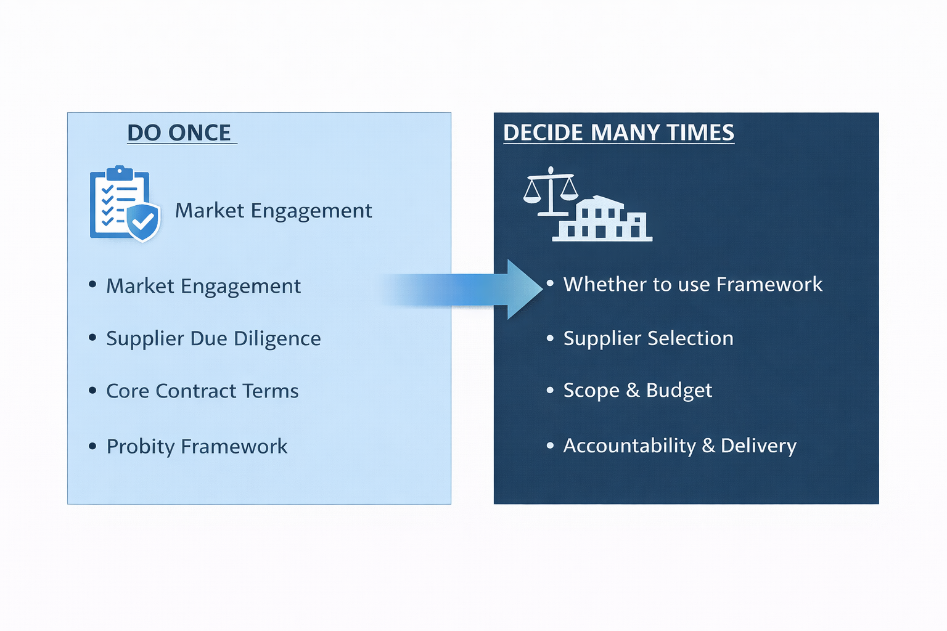
Do Once vs. Decide Many Times
Notes:
This explains the fundamental model behind aggregated procurement
On the left is the work that is done once — centralised
This is the heavy lifting of procurement:
All of that work is undertaken upfront, rigorously and transparently.
Importantly, this does not remove control from councils.
What it actually provides is consistency, compliance and assurance — knowing that the procurement process has already been conducted to a high standard.
On the right is where local decision-making remains firmly with each council.
So, the accountability and operational decisions stay local.

Slide 7
Shared Procurement
Removes Repetition
Heavy Lifting → Done Once
Decisions → Remains Local
Broader Stakeholder Input → Stronger Scope
Notes:
What you’ve just seen is the concept of Shared procurement is how it works in practice.
removes repetition
Heavy lifting is done once
Councils retain accountability
Input from multiple stakeholders delivers a stronger scope
When using Shared Procurement models - You don’t lose control — You lose unnecessary workload.

Slide 8
Why this Matters
Consistency = Lower risk
Procuring Once = Strengthens Probity
Reduced Duplication = Faster access to market
Notes:
This matters​ because
​
Consistency reduces risk.​
​
Doing procurement once strengthens probity.​
​
Reducing duplication – Faster access to market​
​
Consistency is a probity strength, not a weakness.​

Slide 9
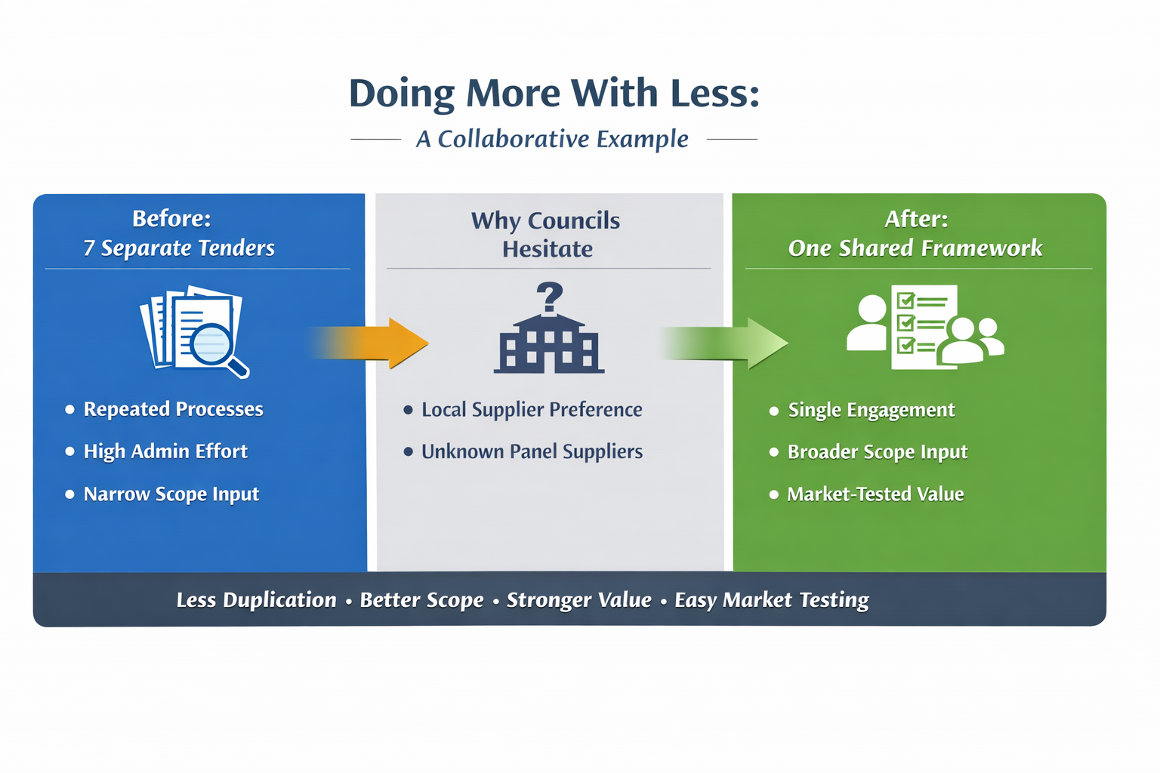
Case Study - Collaboration Without Losing Market Choice
Notes:
A short case study that illustrates how collaboration can simplify procurement without removing market choice.
BEFORE – 7 Separate Tenders
In this example, several councils were independently running their own tenders.
The categories were similar, the suppliers were largely the same, and the probity requirements were identical.
However, each council was investing months in:
Market engagement
Evaluation
Documentation
Negotiation
Often under workforce pressure and limited procurement capacity.
And because each tender was developed independently, the scope was typically shaped by a single group of stakeholders, which limits the breadth of input. When multiple organisations shape a framework together, the resulting scope is often stronger and more comprehensive than what a single council could develop alone.
WHY COUNCILS HESITATE
It’s important to acknowledge why some councils hesitate to use shared procurement frameworks.
Common concerns include:
Local suppliers might not appear on the panel
Unfamiliar suppliers might appear
Or the belief that running a fresh tender will always deliver better value
These are valid considerations.
But the reality is that councils can very easily test whether a collaborative framework offers better value.
They still retain the ability to:
Market test
Compare pricing
Assess supplier suitability
Using a shared framework does not remove competition — it removes repetition.
And repeatedly running tenders with the same suppliers doesn’t automatically produce better outcomes.
In fact, aggregated frameworks can often expand supplier visibility rather than restrict it.
AFTER – ONE SHARED FRAMEWORK
In this case, the councils moved to a single shared procurement framework.
Instead of seven separate engagements, there was one coordinated process.
This delivered:
A single market engagement
Broader input into the scope from multiple stakeholders
And market-tested value
The result is:
Less duplication
Better scope
Stronger value
And easier market testing

Slide 10
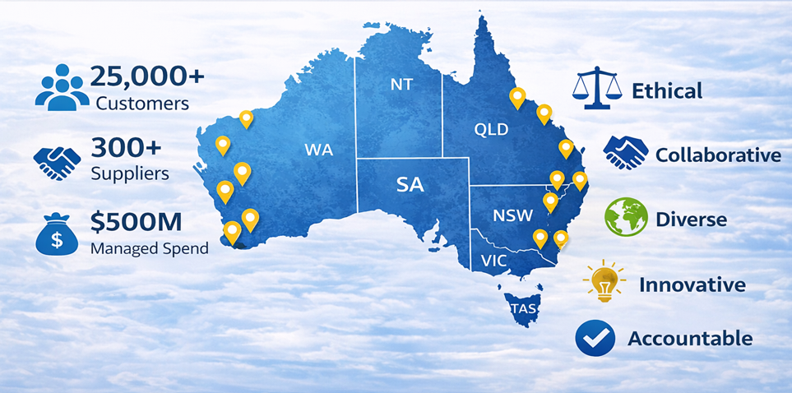
Procurement Australia - Smarter Procurement Greater Impact
For over 40 years, we have partnered with organisations to simplify procurement, unlock cost savings.
Notes:
This is where Procurement Australia assists:
For over 40 years, we have partnered with organisations to simplify procurement & unlock cost savings.
From a reach perspective, Procurement Australia works with over 25,000 customers across the country.
To support those organisations, we partner with more than 300 tier-one suppliers across a wide range of procurement categories.
Through those partnerships we currently help manage over $500 million in customer expenditure each year, which allows organisations to access compliant procurement frameworks without needing to run their own tenders.
But reach alone isn’t what defines Procurement Australia.
Equally important are the values that guide how we deliver those services.
We focus on being ethical in our procurement processes, ensuring transparency and probity.
We prioritise collaboration, both with our members and with suppliers, because shared procurement works best when organisations shape the solution together.
We are committed to diversity, supporting inclusive supplier participation and broad market access.
We encourage innovation, constantly looking for ways to simplify procurement and improve value.
And we emphasise accountability, ensuring that our frameworks deliver compliant, reliable outcomes for the organisations that rely on them.
Together, our reach and our values allow us to support organisations in simplifying procurement while achieving stronger outcomes.

Slide 11





Procurement Australia – Sectors we Service
Government Agencies
Health & Aged Care
Educational Institutions
Commercial & Industrial
Not-for-Profit Organisations
Our 4 decades of expertise in procurement provides compliant, cost- effective solutions for local, state, and federal governments, meeting their diverse operational needs.
We deliver procurement solutions that ensure quality, compliance, and cost-efficiency for health and aged care providers, allowing them to focus on delivering exceptional care.
We support education providers with tailored procurement for safe, functional, and engaging learning environments, from classroom supplies to technology.
Our solutions streamline procurement for businesses, reducing costs, improving efficiency, and supporting growth in commercial and industrial sectors.
We empower not-for- profits to maximise their impact by delivering cost-effective procurement solutions that help them do more with their resources.
Notes:
Our customers span
Local Government
Health & Aged Care
Education
Commercial & Industry
Not for Profit

Slide 12
Our Solutions
Tendered Solutions
Partnership Solutions
  Fully compliant, transparent procurement solutions
  Competitive, best-value offers that meet industry standards
  National Panels / Regional Collaborative Programs
  Fast, streamlined procurement through pre-negotiated deals
  No formal tender process required
  Ready-to-go solutions for quick access to products and services
Our role – We do the heavy lifting once
Our Commitment to a Compliant Procurement Process
Notes:
the two main ways Procurement Australia supports organisations to access suppliers and services.
The first is our Tendered Solutions.
These are fully tendered procurement panels, established through an open and competitive market process.
They are designed to be fully compliant and transparent, giving organisations confidence that suppliers have been evaluated through a rigorous procurement process.
Through these panels, customers can access competitive, best-value offers that meet industry standards, without needing to run their own tender.
Many of our tendered solutions operate at a national level, while others are designed as regional collaborative programs, where multiple councils or organisations come together to achieve stronger collective purchasing outcomes.
The second model is our Partnership Solutions.
These are contracted arrangements with preferred partners, rather than formally tendered panels.
They provide a fast and streamlined procurement pathway, where pricing and commercial terms have already been negotiated.
This means organisations can access ready-to-go solutions quickly.
In practice, organisations often use Tendered Solutions when compliance and market competition are the priority, and Partnership Solutions when speed, efficiency, or a specific solution is needed.
Together, these two approaches provide flexibility for organisations to procure in the way that best suits their needs.

Slide 13
Impact on Teams
Less Administration = Less
  Market Engagements
  Checking Supplier Compliance
  Re-Creating existing Documents
More Commercial value
  Advising
  Managing Risk
  Engaging Suppliers
  Shaping better outcomes
Notes:
The impact
Less administration means less time re-running market engagement, re-checking supplier compliance, and re-creating documentation that already exists
When that burden is lifted, procurement teams spend more time where their judgement matters — advising the business, managing risk, engaging suppliers, and shaping better outcomes, because
when procurement teams are buried in administration, their expertise is under-used.
Shared procurement enables teams to do the work only they can do.

Slide 14
Local Government Impact
Aggregated contracts =
  Shorter lead times
  Stronger Governance
  Reduced procurement fatigue
Notes:
The impact for LG is that
Aggregated contracts reduce lead times and procurement fatigue.
Teams report stronger governance confidence.
It’s not just faster — it provides assurance

Slide 15
What this Enables
Shared frameworks create:
  Collaboration at scale
  Coordinated whole-of-government delivery becomes achievable
Notes:
What this enables
Today hasn’t been about cutting steps or weakening controls.
It’s been about recognising that duplication is often a system response — and that better system design changes behaviour naturally.
When procurement foundations are shared, collaboration becomes possible — and coordinated, whole-of-government delivery becomes achievable
Shared frameworks create the conditions for collaboration and coordinated delivery

Slide 16
When procurement is designed at scale, speed, probity and outcomes reinforce each other

Slide 17
Thank you
Contact Details
Julie Wiggins| General Manager – Local Government
E: jwiggins@paltd.com.au| P: 0429 523 346
Craig Russell | Business Manager – Local Government
E: crussell@paltd.com.au | P: 0475 707 335

